Slide 1


The Link Between Climate and Materials
September 16, 2014
David Allaway
Oregon Dept. of Environmental Quality
allaway.david@deq.state.or.us

Slide 2
Mitigation vs. Adaptation
Mitigation: reducing emissions
Adaptation: reducing vulnerability due to impacts of emissions
Notes:
Linkages go both ways; materials effect climate; climate effects materials. Today I’ll speak primarily about mitigation: how the use of materials effects the climate through greenhouse gas emissions, and options to reduce those emissions.

Slide 3
Traditional Sector-Based View of U.S. Greenhouse Gas Emissions (2006)
Residential
5%
Commercial
6%
Electric Power Industry
34%
Agriculture
8%
Industry
19%
Transportation
28%
Source: US EPA (2009)
Notes:
So, how much do materials contribute to greenhouse gas emissions?

Slide 4
Materials Matter: Systems-Based Geographic Emissions Inventory (2006)
Building Lighting and HVAC
25%
Provision of Goods
29%
Materials
42%
Transportation of People
24%
Provision of Food
13%
Use of Appliances and Devices
8%
Infrastructure
1%
Source: US EPA (2009)
Notes:
. . . (note these are the same emissions)

Slide 5
Oregon 2010 Consumption-Based Emissions by Major Category of Consumption (“Final Demand”)
Notes:
EPA’s sector and system-based inventories were two different ways of slicing the same pie. The same emissions, domestic emissions inside the US, but organized differently.
Here’s a different way of considering emissions: consumption-based. . . .

Slide 6
Oregon’s “In-Boundary” and Consumption-Based Inventories Compared (2010)
“In-boundary” inventory
62.8 MMTCO2e
Consumption-based inventory
74.7 MMTCO2e
Includes emissions associated with the use of electricity
28.2
34.5
40.2
Total 2010 Emissions: 102.9 MMTCO2e
Notes:
And here I want to relate consumption-based emissions to the conventional “in boundary” inventories that most states use. Again for Oregon, here’s . . .
. . . So not only are consumption-based emissions larger, but they also uncover more emissions, and by extension, more opportunities to reduce emissions.

Slide 7
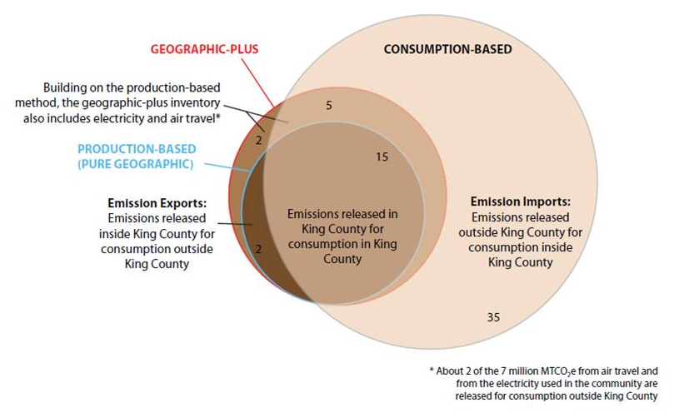
King County (Washington) Inventories Compared (2008)
Notes:
. . . Typically the difference between the two approaches become more pronounced at smaller geographic scales. So here’s the case of King County Washington . . .
. . . Again, consumption-based emissions add quite a bit to our understanding of how we contribute to climate change, and by extension, opportunities to reduce emissions.

Slide 8
Materials Matter: Systems-Based Geographic Emissions Inventory (2006)
Building Lighting and HVAC
25%
Provision of Goods
29%
Materials
42%
Transportation of People
24%
Provision of Food
13%
Use of Appliances and Devices
8%
Infrastructure
1%
Source: US EPA (2009)
Notes:
So materials are significant? Why and how? Here’s the US systems-based inventory again, remember the 42% on the left-hand side.

Slide 9
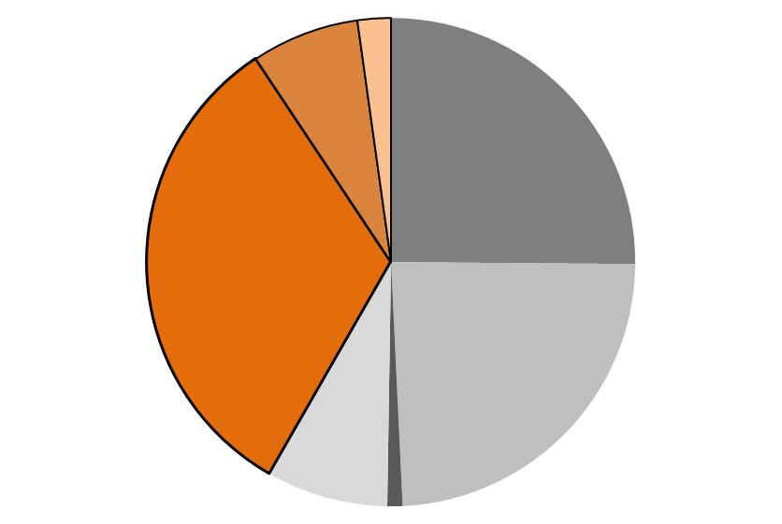
For Materials, “Upstream” Emissions Dominate
Provision of Materials
42%
Landfills & Wastewater
2.2%
Freight
7.1%
Building Lighting and HVAC
25%
“Upstream” Processes
32.2%
Transportation of People
24%
Use of Appliances and Devices
8%
Infrastructure
1%
Notes:
Here are the same emissions roughly organized into different stages of the life-cycle.
I’ll mention that the landfill numbers here are somewhat controversial. They may be higher than shown here. Landfill methane emissions are notoriously difficult to actually measure. So what’s shown here are not measured emissions but rather the results of models and of course the assumptions that go into those models.

Slide 10
Opportunities
“Downstream”:
Landfill gas controls
Increasing recovery (recycling, composting)
“Upstream”:
Low-carbon production, transportation
Material substitution
Using fewer materials (waste prevention, reuse)
Notes:
What then are the opportunities to reduce emissions associated with materials? One way to categorize the options is whether they occur downstream of the consumer, that is, involving wastes and the management of wastes, or upstream of the consumer, involving production and consumption. So for example . ..
Let’s talk briefly about some of these. Landfill gas controls – fairly easy, often cost-effective, especially when coupled with energy recovery. Important – methane a highly potent gas – but at the end of the day, if you go back to this picture – really just scraping the tip of the emissions iceberg.

Slide 11
Energy and Greenhouse Gas Benefits of Recycling
Recycling in Oregon in 2012 saved ~34 trillion BTUs of energy
    ~3.3% of total statewide use
    Equivalent of ~272 million gallons of gasoline
Waste recovery in Oregon in 2012 reduced greenhouse gas emissions by ~3.1 million metric tons of CO2e
    ~4.6% of total statewide emissions
    Equivalent of 690,000 “average” passenger cars
    Most of these reductions are “upstream” as recycled materials displace virgin feedstocks
Notes:
Recycling and composting offers greater emissions reduction potential, and while recycling is thought of us a downstream activity, most of the emissions reductions occur upstream, in manufacturing. For example . ..

Slide 12
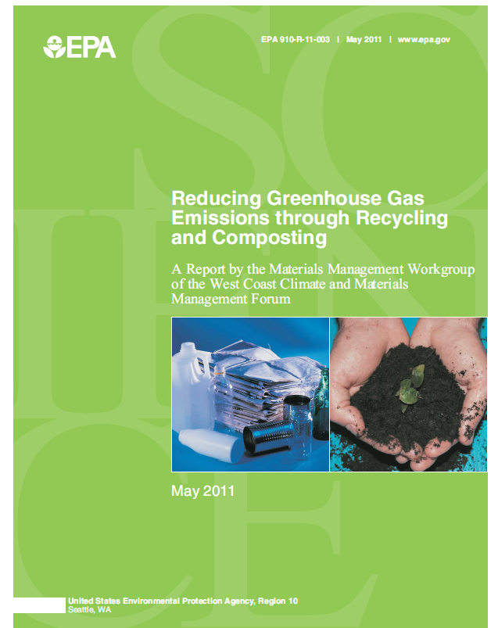
Analysis of GHG Reduction Potential (Recycling and Composting)
Notes:
On that note, one of the Forum’s first work products was this document here: Reducing GHG Emissions through Recycling and Composting (PDF). This report identifies the top ten materials in California, Oregon, and Washington with the greatest potential for reducing GHG emissions if diverted from landfill disposal through recycling and composting. I’ve seen this report cited and referenced all over the place, and in Oregon, we used these same ideas of prioritizing materials both when updating our state’s solid waste plan, and also now as we implement that plan, our 2050 Vision, we’re using it to focus our new recovery initiatives, focusing more on the high-impact materials of plastics and food waste, two materials called out by this Forum report as priorities.

Slide 13
The importance . . . and limitations . . . of waste recovery (recycling, composting)
“savings”
6%
buildings
buildings
provision of
materials
provision of
materials
36%
42%
transporting
people
transporting
people
appliances
& devices
appliances
& devices
2006 U.S. GHG inventory
with 32% recovery
(MSW)
2006 U.S. GHG inventory with
very high recovery rate
(~95% MSW + >70% C&D)
Notes:
So waste recovery is important, and offers good potential to reduce emissions. But let’s not put all of our eggs in this one basket. Because the potential to reduce emissions is still somewhat limited . . .

Slide 14
Upstream
Low-carbon production
Material substitution
  Recyclable materials?
Using fewer materials (waste prevention, reuse)
Notes:
Turning to upstream actions . . .
. . . What about recyclable materials. Since recycling is better than disposal, a very popular belief is that we should choose materials that are easy to recycle. Making the waste stream more recyclable enables more recycling, and that reduces emissions.
Unfortunately, this perspective is missing the big picture. For most products and packaging, the impacts of production are far greater than the potential benefits of recycling. Further, just because product A is made from recyclable materials, and product B is not, does not mean that product A inherently has a lower carbon footprint. In fact I could point to several well-documented examples where the recyclable product actually has the higher carbon footprint. So materials substitution needs to consider the big picture . . .

Slide 15
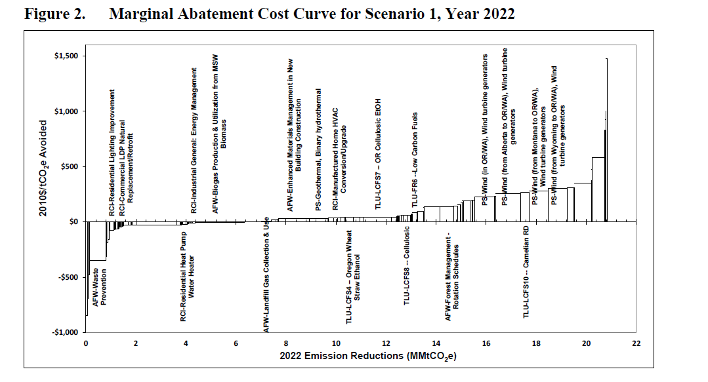
Oregon Marginal Abatement Cost Curve Project

Slide 16

Consumption Workgroup
Notes:
A few years into the Forum, the leadership team recognized that there was a lot of interest in the topic of consumption, and we weren’t really organized to address it. So we held a special retreat for members and explored the topic of consumption in more detail. From that retreat our newest workgroup was formed, the consumption workgroup. And it has really focused on three areas: first, sharing information about methods of making consumption more sustainable, second, government procurement, and third, food waste prevention.
I’ve already mentioned the Forum’s two, year-long webinar series on consumption, a topic that many members have been interested but didn’t really know how to explore. These presentations are available to Forum members.
Another initiative around consumption is a subgroup looking at low-carbon procurement by state and local governments. Here, the Forum is in the middle of a project to develop tools for public agencies to use in making carbon footprint-focused purchasing and contracting/services decisions. You may have heard a little about this in another Forum webinar last month, and stay tuned for a release of some really great tools in the months to come.

Slide 17
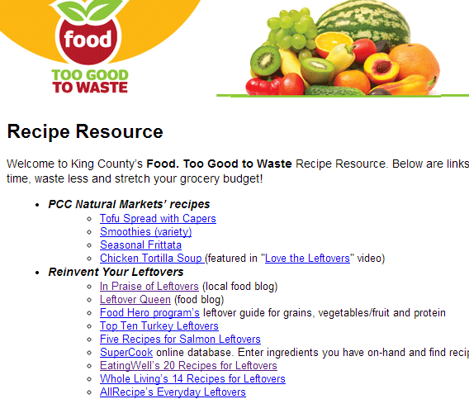
Food: Too Good to Waste
Notes:
The consumption workgroup’s other project has been the development and pilot testing of the Food: Too Good to Waste toolkit. Using principles of community-based social marketing, the Forum developed key messages and materials to be used in changing individual household behaviors around the purchase and wasting of food. Here’s an example of where the Forum again identified a gap, and got ahead of a trend, and the Forum’s pilot work on the west coast has become the foundation of new national initiatives.

Slide 18
Research Workgroup
Changing Consumer Behavior
Waste Prevention
Product Design and Packaging
Organic Wastes
Optimal Waste Management Pathways
Collaborative Consumption in the Sharing Economy
Notes:
Another project of the Forum has been to do research on behalf of the membership. The Forum’s research workgroup surveyed both members and experts to identify what the most important research questions were, and then worked with an EPA contractor to conduct an initial literature review of 10 priority topics, identifying over 300 journal papers and other documents in ten broad topic areas. Workgroup members have reviewed the literature and put together research summaries on 6 of these topics (list).

Slide 19
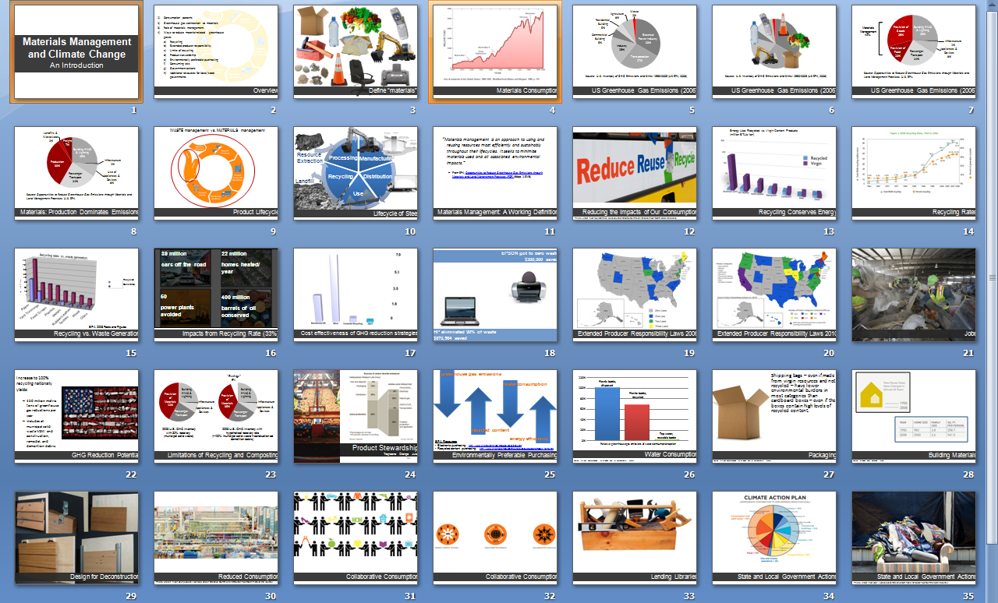
West Coast Forum’s Scripted Presentation
Notes:
One of the Forum’s earliest projects was a scripted presentation, put together by the Communications Workgroup, designed to help non-experts communicate the climate-materials connection to their local audience. It is designed for local and state governments to be able to educate policy makers, inform climate action planning, and help support projects that minimize the impacts from materials. It is still available, and still getting downloaded. If you’re looking for an easy way to communicate this topic to folks in your community, I’d encourage you to check it out.

Slide 20
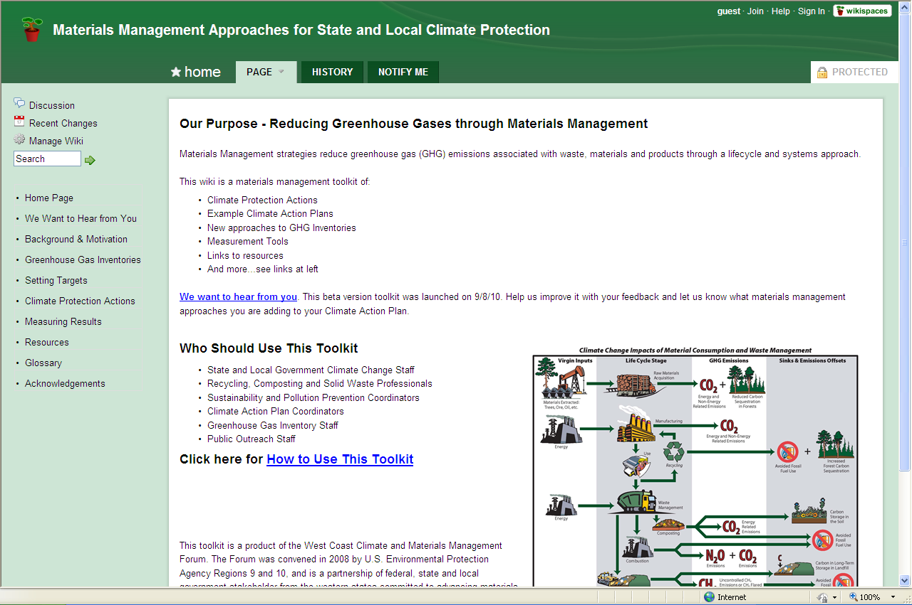
Inventory and Climate Action Planning Toolkit
Notes:
The Forum has also created an on-line toolkit to help local governments and others both understand alternative inventory approaches, as well as opportunities to take action to reduce climate impacts through both waste recovery and more upstream practices. We’ve made such progress in the last 18 months that some of the content on this website is no longer current, but that’s next on our group’s workplan. Still, last year, with almost no promotion on the Forum’s part, this site was viewed almost 30,000 times by more than 24,000 unique visitors, so it seems to be well received.

Slide 21
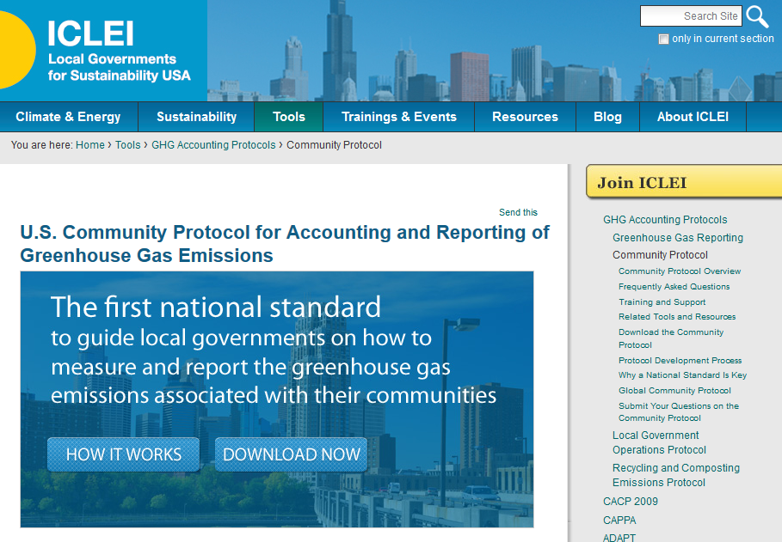
ICLEI – Community Inventory Protocol
Notes:
Forum members, including members of the Inventory Workgroup, also played key roles in the development of two national protocols. The first, ICLEI’s Community Protocol, is the first US guidance for conducting greenhouse gas inventories at the community scale. It represents a quantum leap forward in inventory guidance, and addresses many of the grievances that the materials management community has had with historic inventory practice. It is not perfect, but still represents a huge advance. One grievance it didn’t address was lack of clear standards for accounting for the benefits of community-scale recycling and composting, and so ICLEI,
Animate
. . . again with help from several Forum members, subsequently produced this second document, on the right, which cities and counties can use to estimate the GHG benefits of community-scale waste recovery programs, and report out alongside their inventory reports.

Slide 22


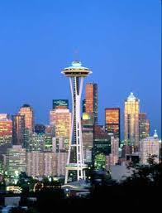
West Coast Leadership
Notes:
I want to reflect on how much progress we’ve made here. Just six years ago, if you were a recycling coordinator and you also cared about the climate, there weren’t many tools – or people - available to help you. EPA’s WARM tool could help you estimate benefits of different scenarios, but that was about it. There was almost nothing focused upstream, on purchasing, consumption or reuse. There were a bazillion unanswered questions floating around. And if you tried to talk with your local climate office, a typical response was “oh, recycling, you don’t really matter” or worse, “oh, recycling, yeah, that reduces emissions but our accounting system doesn’t acknowledge them, so go away.”
Animate
Now a lot has changed for the better. In California, the Air Resources Board’s emissions reduction scoping plan in 2008 acknowledged the potential emissions reductions from the waste sector of 10 million metric tons. In last year’s update, this estimate moved up to 20 to 30 million metric tons. The increase is in part a result of CalRecycle getting serious about the climate protection benefit of recycling, and changing the state’s goals from 50% landfill diversion to 75% recycling. And even though the Air Resources Board is only counting landfill methane reduction towards the state’s in-boundary emissions reduction goals, it acknowledges the much larger, upstream emissions reduction potential of recycling, and including these in the scoping plan set the stage for possible incentive funding to build the state’s recycling infrastructure through cap and trade allowance auction revenues. In fact, this year’s state budget includes $30 million in cap-and-trade proceeds for recycling, composting, recycled-content manufacturing and organic waste to energy projects. That is huge progress and congratulations to all the folks in California who helped make that happen!
Animate
There’s good things happening in Oregon and Washington too. Oregon’s 2050 Vision is providing a roadmap for moving upstream, and shifting from a narrow focus on waste to a broader and more holistic view, reducing environmental impacts over the full life of materials. We’re working with builders, architects, and cities to incentivize changes in urban forum, specifically the promotion of accessory dwelling units, in part to prevent waste and also to reduce emissions. Oregon and Washington are working together to evaluate the benefits and barriers of product environmental footprinting by brand-owners, and steps the states or others could take to make footprinting more accessible. Washington state is updating its “Beyond Waste Plan” and its Consumer Environmental Index (the CEI), which provides a measure of GHG emissions from consumption in the state
There are also exciting developments underway at the level of local government. Just as one example, the City Council of Eugene just passed a resolution directing staff to evaluate the feasibility of adopting not a carbon reduction goal, but a climate stabilization goal, for the City. Staff there are also working with the Urban Sustainability Director’s Network on a project to develop indicators and measurement of sustainable consumption, and some exciting research and consultation on the role of cities in advancing sustainable consumption.
This upstream work is still somewhat exploratory. It is somewhat reminiscent of curbside recycling in the 1970s, a handful of pioneers trying out different ideas. But if we’re going to make the deep cuts in emissions that are needed, we have to figure out how to do this type of work, and do it well. If that’s not your cup of tea, that’s fine too. We also need low-carbon production, and we need more and better recycling, and even still better landfill gas controls too. Reducing emissions through materials management is a very big tent, and on that note I think I’ll stop and we can have some discussion. Thanks.

