Slide 1
US Engagement in the10YFP
Briefing on the 10-Year Framework of Programs on Sustainable Consumption and Production Patterns (10YFP)
Webinar Series on “Materials Management through Sustainable Consumption”
May 14, 2013

Slide 2
What is the 10YFP?
A commitment made by governments at the World Summit on Sustainable Development (2002) to:
“Encourage and promote the development of a 10-year framework of programmes in support of regional and national initiatives to accelerate the shift towards sustainable consumption and production to promote social and economic development within the carrying capacity of ecosystems by addressing and, where appropriate, delinking economic growth and environmental degradation through improving efficiency and sustainability in the use of resources and production processes, and reducing resource degradation, pollution and waste.”

Slide 3
10YFP—Ten Years in the Making
“Marrakech Process” Task Forces/Advisory Group (2003-11)
CSD-19 (2011)--disappointing outcome
Rio+20 “Green Economy” agenda—good platform for 10YFP
10YFP “Adopted” as Rio+20 voluntary initiative (June 2012)
UN General Assembly Resolution authorized (Dec. 2012)
UNEP GC decision authorized UNEP support (Feb. 2013)

Slide 4
10YFP Governance Structure
Member State Body
(ad interim)
@ ECOSOC
10 YFP Secretariat
@ UNEP/DTIE
10YFP Board
w/ 10 Member State reps
(2 per UN Region)
10YFP Programs:
o Consumer Information
o Sust. Lifestyles and Education
o Sust. Public Procurement
o Sust. Bldgs and Construction
o Sust. Tourism, incl. Ecotourism
* Life Cycle Assessment
* Think.Eat.Save (food waste)
Other 10YFP Program Elements:
o SCP Clearinghouse
o Voluntary Trust Fund
o UN Interagency
Coordination Group
o Meetings/Reports
o Five Year Review
10YFP Focal Points:
o Member States
(EPA for U.S.)
o Other Stakeholders (tbd)

Slide 5
Current Status on10YFP Programs:
Draft “Common Template” and Process to Register Programs Being Reviewed.
Initial Attention:
Sustainable Public Procurement Initiative
Expanded LCA Cooperation Platform— Data and Tools
SCP/Green Growth Knowledge Platforms

Slide 6
Current Status of10YFP Programs (Cont.):
Investigating/On the Radar:
Think.Eat.Save—Reduce Your Foodprint (FAO/UNEP)
Resource Efficient/Sustainable Cities (UNEP/UN Habitat/WB)
Cleaner Production (UNEP/UNIDO)
Green Growth Policy Menu/Network (WB,OECD,UNEP,DESA,G-20)
Green Chemistry (UNIDO, GEF, UNEP, OECD)
Corporate Sustainability Auditing/Reporting (FOP88, wbcsd)
Others ???

Slide 7
Next Steps
Establish 10YFP inter-agency group
Develop guidelines for USG inputs into 10YFP
Inventory of key domestic and int’l programs/tools
Options and plan for US 10YFP Website and integration into “Global SCP Clearinghouse”
Focal point coordination w/ 10YFP Secretariat and Board, and US stakeholder outreach
Possible Regional Consultation (e.g. WEOG)

Slide 8

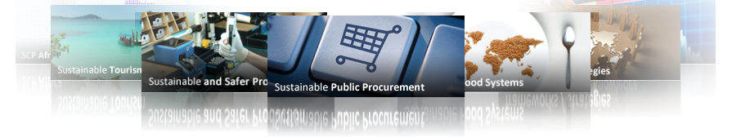

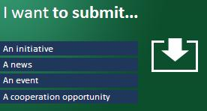
The Global SCP Clearinghouse
1
2
3
4
5
Platform for the 10YFP Serve as the information hub for the 10-Year Framework of Programmes (10YFP) | Promote SCP Inspire policy-makers, the business sector and civil society around the globe to share experience and take action | Collect and disseminate information, knowledge, tools and best practices, on SCP through user-friendly worldwide databases and communities | Networking and partnerships Build cooperation at all levels through a cooperation market place, directory of experts and working groups | Track news and events Learn about and share latest news and events on SCP initiatives worldwide
An evolving platform with hosted communities
Where users are the actors
Notes:
The Global SCP Clearinghouse is meant to be the unique one-stop hub that brings together the SCP community worldwide. It stands for an harmonized knowledge and experience sharing platform that will lead to more innovation and cooperation towards SCP implementation.
The Global SCP Clearinghouse is built upon 3 key principles:
A transversal platform that hosts regional and thematic communities: a unique place to browse a diversity of regional and thematic SCP communities, from sustainable public procurement, cities and buildings to sustainable and safer production or sustainable lifestyles and education.
2) Users are the actors: the contents and activities of the Global SCP Clearinghouse’s are provided by the users. They are the beating heart of the Clearinghouse and they ensure it remains active and alive.
3) Decentralized management: the communities hosted by the Global SCP Clearinghouse are managed through an innovative and decentralized system that allows broad participation and ownership from different organizations and partners around the globe.

Slide 9
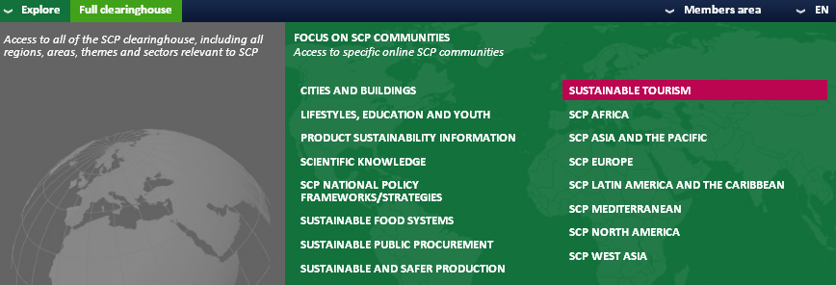
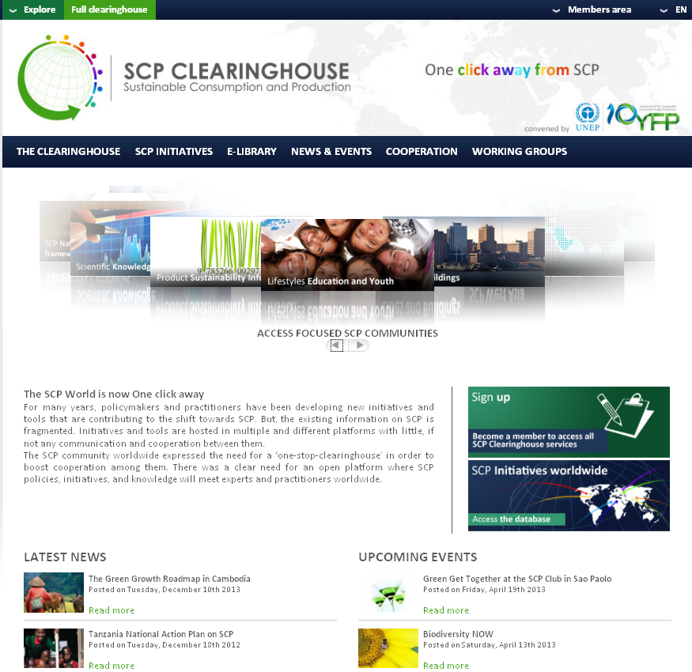
Notes:
Note: this slide is animated, please run the slide show
1) Presenting the Global SCP Clearinghouse homepage:
Welcome on the home page of the Global SCP Clearinghouse!
From here you can access all the communities, have a look at the latest news or events about SCP and start browsing the database of SCP initiatives around the world.
You can also sign in! Do not hesitate to do so, it is free, you will become a member, have access to a very handy personal account and it will enable you to share contents and ideas with others on the platform.
Do not forget the Explore menu in the header which is a very handy tool that will give you access to any pages on the Clearinghouse no matter what page you are currently on.
2) Introducing the rest of the presentation: everything you can do with the Global SCP Clearinghouse but never dared to ask…
Find out what is happening on SCP and share information
Build networks, identify partners
Strengthen capacities

Slide 10
Discussion and Questions? USG 10YFP Contacts: EPA Office of Global Affairs and Policy: Hodayah Finman, U.S. 10YFP National Focal Point (Finman.Hodayah@epa.gov) Ted MacDonald, Alt. Focal Point and Initiative Lead (MacDonald.Ted@epa.gov) State Department Office of Oceans, Environment, and Science: Kit Norland, Alternate U.S. 10YFP National Focal Point (Norland.PD@state.gov

